Slide 1

EXPLORATORY DATA ANALYSIS
Presented By : Master minds Team

Slide 2
Contents
Introduction to Team and Dataset
Problem Statement
Our Work
Tools and Techniques
Conclusion

Slide 3

INTRODUCTION TO TEAM MEMBERS AND DATASET

Slide 4
MEET THE TEAM
ADEENA ALAM
KARAN KUMAR
SAGAR KUMAR
BAKHTAWAR
JUNAID JAVED

Slide 5
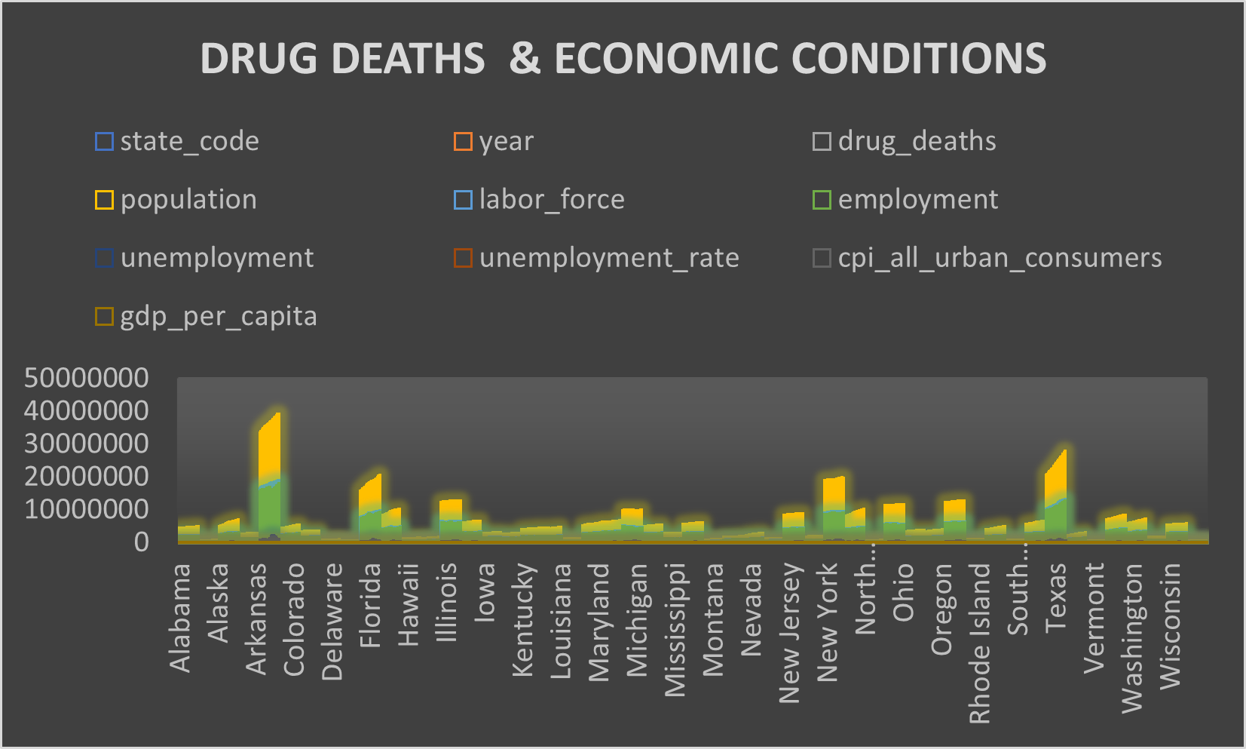
DATASET

Slide 6

PROBLEM STATEMENT

Slide 7

PROBLEM STATEMENT
EFFECT OF DRUG DEATHS ON DIFFERENT STATES
UNEMPLOYMENT AND EMPLOYMENT RATIOS DUE TO FIRST PROBLEM STATEMENT
EFFECT ON ECONOMIC CONDITIONS OF STATES LIKE GDP & CPI

Slide 8

Our Work

Slide 9
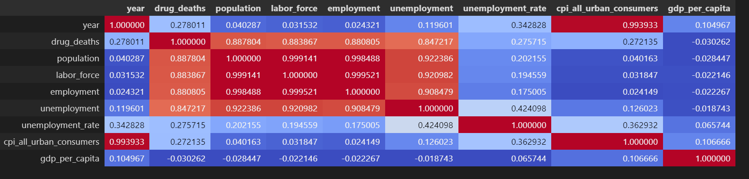
Correlation

Slide 10
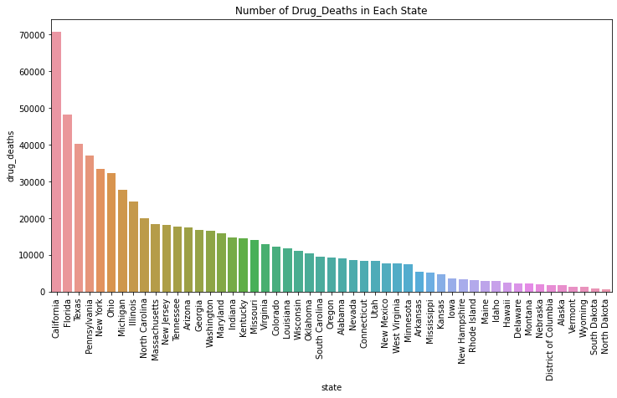
Drug Deaths In Different States

Slide 11
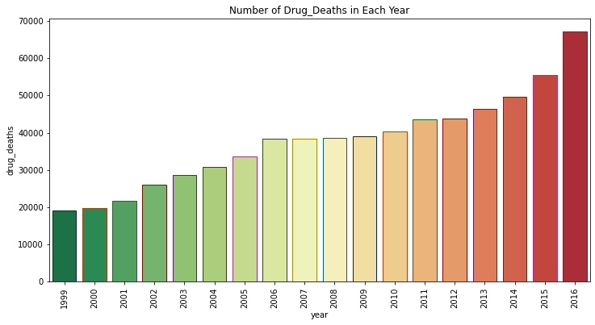
Drug Deaths In Each Year

Slide 12
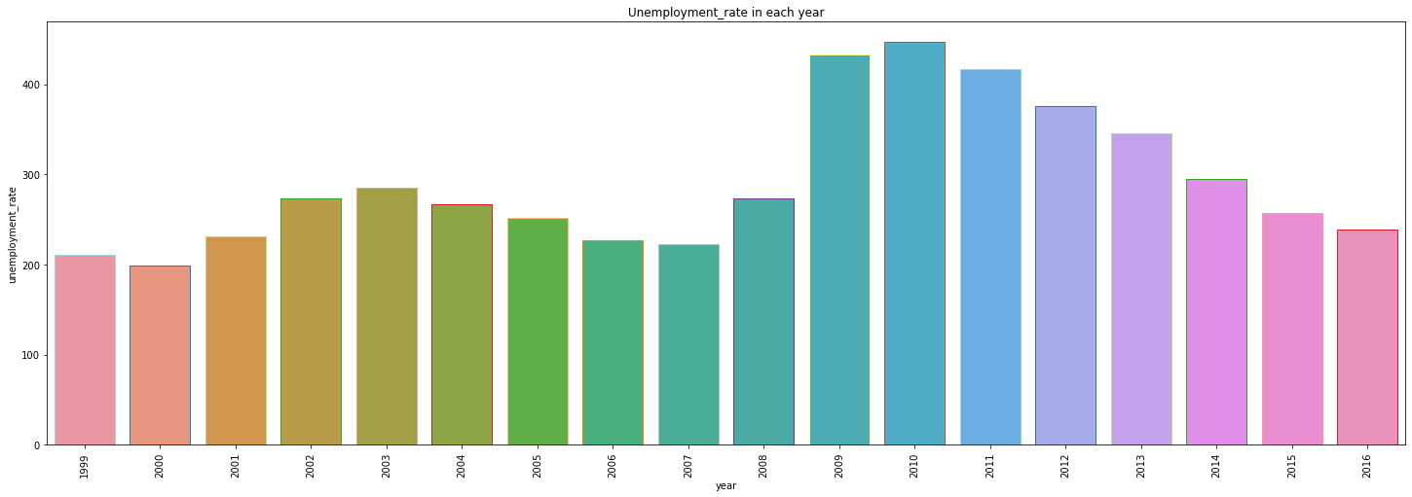
Un-employment Rate In Each Year

Slide 13
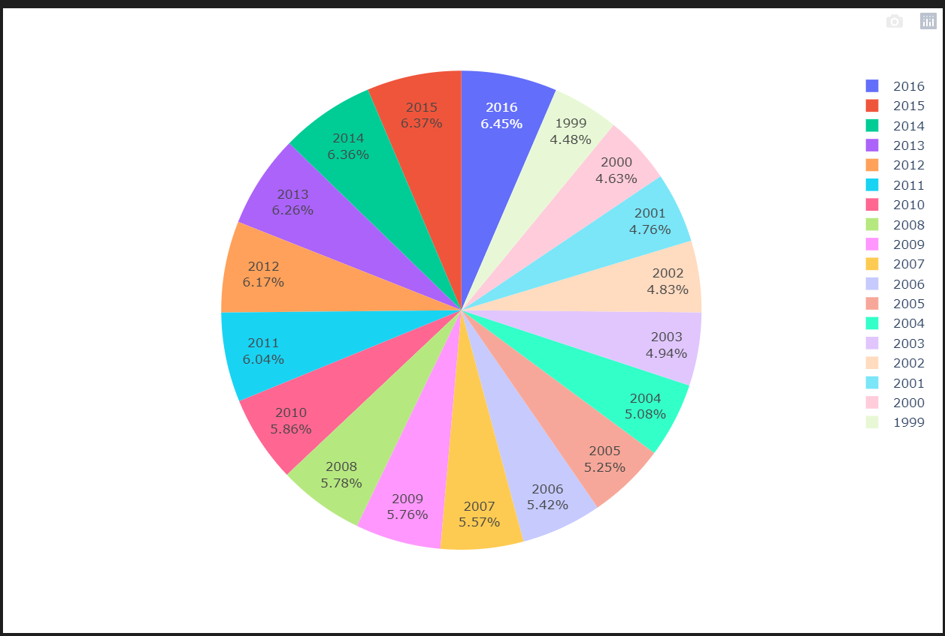
CPI Rate In Each Year

Slide 14

TOOLS & TECHNIQUES

Slide 15




Tools

Slide 16
Techniques
BAR PLOT
PIE CHART
SCATTER PLOT
HEAT MAP

Slide 17
Conclusion
In this dataset , drug deaths is the input feature which relates with other different features like unemployment rate , CPI rate , GDP rate.
With the help of Exploratory Data Analysis techniques , we conclude that mostly drug deaths occurred in Calfornia state and mostly drug deaths occurred in 2016 year.

Slide 18


